Slide 1

QUALITY SHORT FORM VIDEO AND ADVERTISING THROUGH TO 2015
#yshortcast

Slide 2

what is shortcast?
is about quality
is the commercial advertising opportunity in a world of short form video proliferation and consumption
opportunities occur when short form video content (<5mins long) meets a minimum level of quality to warrant being ad supported
by ad supported we mean an ad that a consumer must view before they can view their content
is the future
Source: Yahoo! Shortcast research, March 2011

Slide 3


audiovisual growth
video online
TV
24.7m
short form viewers (<5 mins)
£54m (+91%)
video advertising growth
+ 2hrs
linear TV viewing
+16%
ITV ad revenue
Source: Yahoo! Shortcast research, March 2011/IAB/ComScore/Screendigest/BARB/ITV
Notes:
3

Slide 4

sizing up the opportunity
% video users consuming short video monthly
77%
Source: Yahoo! Shortcast research, March 2011

Slide 5

% of video viewers who view short form weekly
%
status
quo
the future
Source: Yahoo! Shortcast research, March 2011
Notes:
71% or video viewers will view short form video clips weekly
5

Slide 6

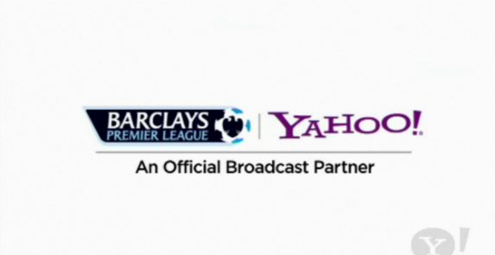
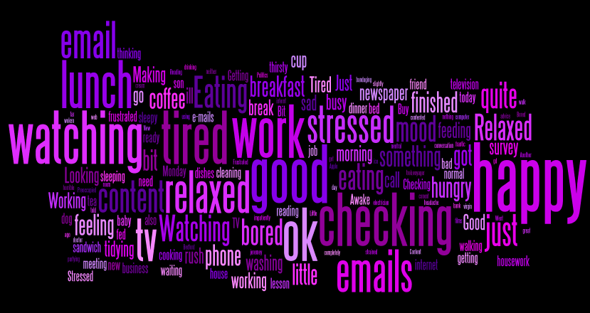

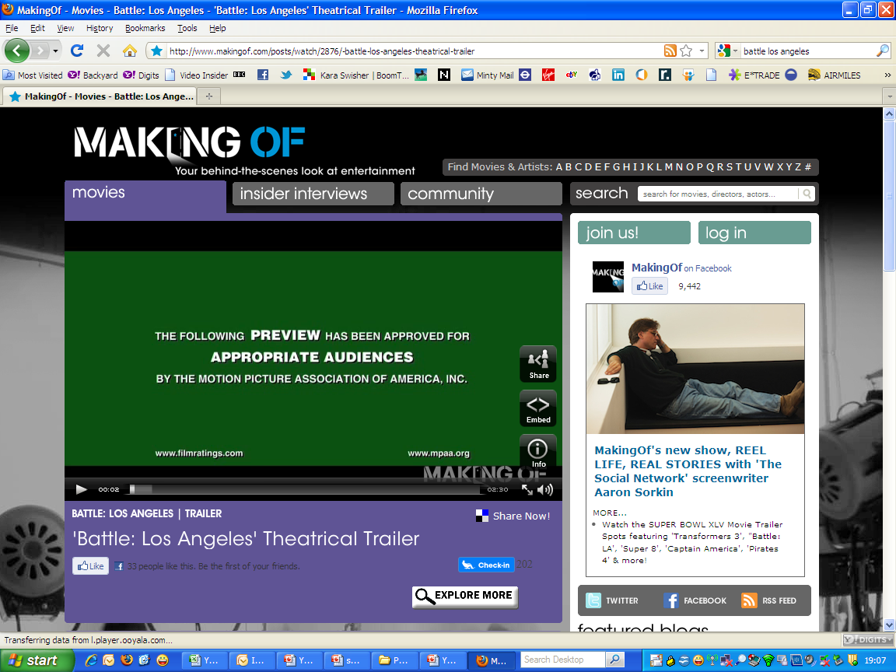

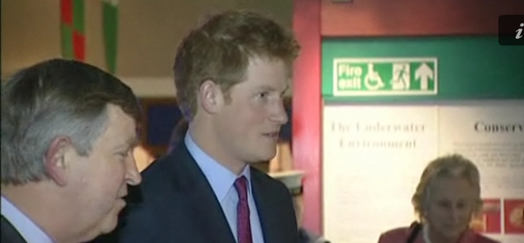
monday 10am – checking
sport
trailers
current affairs
Source: Yahoo! Shortcast research, march 2011

Slide 7
360^{O} triggers
  sent something
  music listening
stumble upon
info seek
‘how to’
  indulging in interests
bored – seek distraction
keeping
‘looped in’
Source: Yahoo! Shortcast research, march 2011

Slide 8

live is the aspiration
sport clip viewing
time specific
place specific
‘wanted to see the goals… it’s much easier and quicker than MOTD’
(male, aged 45-54)
Source: Yahoo! Shortcast research, March 2011

Slide 9

interactivity needs clear benefits
I would like to be able to interact more with the online videos I watch
Click here for more
18% agree
41% unsure
41% disagree
Source: Yahoo! Shortcast research, March 2011

Slide 10




















% of people who’ve not seen ads supporting genre clips
under 10%
film
TV
soaps/drama
travel
10-15%
autos
celeb/ents
home/garden
health
autos
fashion/beauty
music
documentary
16-20%
sport
kids TV
comedy
adult
21 - 30%
science/tech
news
viral
ugc
Source: Yahoo! Shortcast research, March 2011
Notes:
Not seen ads
Film / Trailers 8%
TV 8%
Drama / soap 8%
Advertising clips 8%
Travel 9%
Car/motoring 10%
Celebrity & entertainment 10%
Home & garden 10%
Health 10%
Cooking 12%
Beauty & fashion 13%
Music videos 14%
Documentary 14%
Sport 16%
Kids programmes / Cartoon 18%
Comedy 19%
Adult entertainment 20%
Science & technology 23%
News / current affairs 26%
Viral 28%
UGC 29%

Slide 11
social: many touch points to spread media
I tell people about clips
I have seen in person
I forward links to video clips to friends, family members or colleagues via email
word of mouth
59%
email
37%
I post video clips on social networking sites
I email links to short clips to myself to watch later
social
25%
self
15%
Source: Yahoo! Shortcast research, March 2011

Slide 12
the blurb
full insights deck available after we come present to you at your work and get your valuable feedback
all slides and videos are nickable if you credit them as being from Yahoo!
source: Shortcast, Yahoo! March 2011
Contact Patrick Hourihan (hourihan@yahoo-inc.com) or your local sales rep for more details
#yshortcast

Slide 13
QUALITY SHORT FORM VIDEO AND ADVERTISING THROUGH TO 2015

